Slide 1
Unit 1 Chapter 2
Intelligent Agents
Agents and environments, good behavior, concept of rationality, nature of environments, structure of agents.

Slide 2
Review of Intelligent Agents
Motivation
Objectives
Introduction
Agents and Environments
Rationality
Agent Structure
Agent Types
Simple reflex agent
Model-based reflex agent
Goal-based agent
Utility-based agent
Learning agent

Slide 3
Introduction to Intelligent Agents
Motivation
Agents are used to provide a consistent viewpoint on various topics in AI
Agents require essential skills to perform tasks that require intelligence
Intelligent agents use methods and techniques from the field of AI
What is an agent?
In general, an entity that interacts with its environment
Perception through sensors
Actions through effectors or actuators
Agent and its environment
An agent perceives its environment through sensors
The complete set of inputs at a given time is called a percept
The current percept, or a sequence of percepts may influence the actions of an agent
It can change the environment through actuators
An operation involving an actuator is called an action
Actions can be grouped into action sequences

Slide 4
AGENTS and ENVIRORNMENTS
An agent is anything that can be ENVIRONMENT viewed as perceiving its environment through sensors and SENSOR acting upon that environment through actuators.
ACTUATOR :A human agent has eyes, ears, and other organs for sensors and hands, legs, vocal tract, and so on for actuators.
A robotic agent : cameras and infrared range finders for sensors and various motors for actuators.
A software agent receives keystrokes, file contents, and network packets as sensory inputs and acts on the environment by displaying on the screen, writing files, and sending network packets.

Slide 5
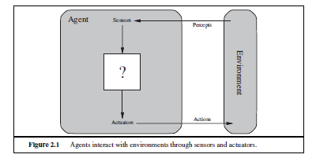
Intelligent Agents

Slide 6
Basic Concepts
percept : agent’s perceptual inputs at any given instant.
agent’s percept sequence : complete history of everything the agent has ever perceived.
agent’s choice of action : entire percept sequence observed to date, but not on anything it hasn’t perceived.
agent’s behavior is :agent function that maps any given percept sequence to an action.
tabulating the agent function that describes any given agent;
Internally, the agent function for an artificial agent will be implemented by an agent program.
The agent function is an abstract mathematical description

Slide 7
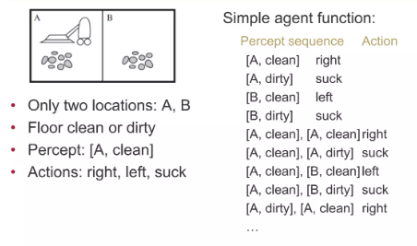
Vacuum-Cleaner World

Slide 8
GOOD BEHAVIOR: THE CONCEPT OF RATIONALITY
rational agent does “the right thing”
The action that leads to the best outcome under the given circumstances
An agent function maps percept sequences to actions
Abstract mathematical description
An agent program is a concrete implementation of the respective function
It runs on a specific agent architecture (“platform”) on physical devices.
Problems:
What is “ the right thing”
How do you measure the “best outcome”

Slide 9
Rationality
Rational at any given time depends on four things:
The performance measure that defines the criterion of success.
The agent’s prior knowledge of the environment.
The actions that the agent can perform.
The agent’s percept sequence to date.
Definition of a rational agent:
For each possible percept sequence, a rational agent should select an action that is expected to maximize its performance measure, given the evidence provided by the percept sequence and whatever built-in knowledge the agent has.

Slide 10
Rationality and omniscience
An omniscient agent knows the actual outcome of its actions and can act accordingly; but omniscience is impossible in reality.
Rationality maximizes expected performance, while perfection maximizes actual performance.

Slide 11
Rational agent and Omniscience
Omniscience
An omniscient agent knows the actual outcome of its actions and can act accordingly; but omniscience is impossible in reality
learning
Rational agent:
Learn and gather information from what it perceives.
The agent’s initial configuration could reflect some prior knowledge of the environment, but as the agent gains experience this may be modified and augmented.
There are extreme cases in which the environment is completely known a priori.

Slide 12
Rational agent and Omniscience
autonomy
A rational agent should be autonomous—it should learn what it can to compensate for partial or incorrect prior knowledge.
task environment
Task environments, which are essentially the “problems” to which rational agents are the “solutions.

Slide 13
Specifying the task environment
PEAS (Performance, Environment, Actuators, Sensors)
An automated taxi driver.

Slide 14
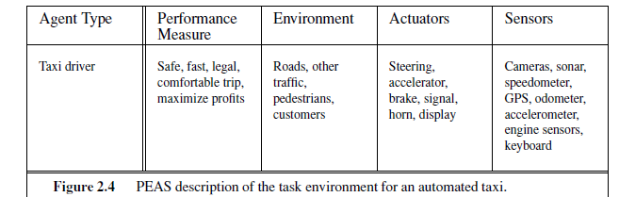
Task environment
The full driving task is extremely open-ended.
PEAS description for the taxi’s task environment.

Slide 15
performance measure : getting to the correct destination; minimizing fuel consumption, and wear and tear; minimizing the trip time or cost; minimizing violations of traffic, laws and disturbances to other drivers; maximizing safety and passenger comfort; maximizing profits.
environment : roads, pedestrians, stray animals, road works, police cars, puddles and potholes, interact with potential and actual passengers.
actuators: control over the engine through the accelerator and control over steering and braking. Output to a display screen or voice synthesizer to talk back to the passengers, and perhaps some way to communicate with other vehicles, politely or otherwise.
sensors: one or more controllable video cameras ,infrared or sonar sensors to detect distances to other cars and obstacles. A speedometer, and to control the vehicle properly, especially on curves, it should have an accelerometer. GPS, Fuel sensors. Finally, it will need a keyboard or microphone for the passenger to request a destination.

Slide 16
software agents (or software robots or softbots) exist in rich, unlimited domains.
Imagine a softbot Web site operator designed to scan Internet news sources and show the interesting items to its users, while selling advertising space to generate revenue.

Slide 17
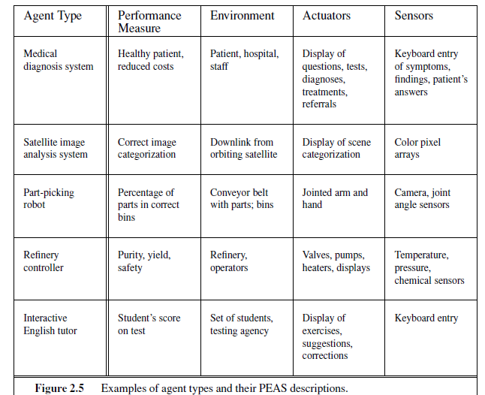
Properties of task environments

Slide 18
Properties of task environments
Fully observable vs. partially observable:
Single agent vs. multiagent
Deterministic vs. stochastic
Episodic vs. sequential
Static vs. dynamic:
Discrete vs. continuous
Known vs. unknown

Slide 19
Properties of task environments
Fully observable vs. partially observable:
If an agent’s sensors give it access to the complete state of the environment at each point in time.
All aspects that are relevant to the choice of action;
agent need not maintain any internal state
partially observable: because of noisy and inaccurate sensors or because parts of the state are simply missing from the sensor data.
a vacuum agent with only a local dirt sensor cannot tell whether there is dirt in other squares, and an automated taxi cannot see what other drivers are thinking.
If the agent has no sensors at all then the environment is unobservable.

Slide 20
Properties of task environments
2.Single agent vs. multiagent:
an agent solving a crossword puzzle by itself is clearly in a single-agent environment
agent playing chess is in a two agent environment.

Slide 21
3.Deterministic vs. stochastic
If the next state of the environment is completely determined by the current state and the action executed by the agent.
otherwise, it is stochastic.
If partially observable-→ could be stochastic.
The environment is uncertain if it is not fully observable or not deterministic.
Nondeterministic environment is one in which actions are characterized by their possible outcomes, but no probabilities are attached to them.

Slide 22
4.Episodic vs. sequential
The agent’s experience is divided into atomic episodes.
In each episode the agent receives a percept and then performs a single action.
Next episode does not depend on the actions taken in previous episodes. Many classification tasks are episodic
sequential :
current decision could affect all future decisions.
Ex:Chess and taxi driving are sequential: in both cases, short-term actions can have long-term consequences.
Episodic environments are much simpler than sequential environments because the agent does not need to think ahead.

Slide 23
5.Static vs. dynamic
The environment and agent changes - dynamic otherwise, static.
Static environments are easy to deal with because the agent need not keep looking at the world while it is deciding on an action, nor need it worry about the passage of time.
Ex:Crossword puzzles are static.
Dynamic environments are continuously asking the agent what it wants to do; if it hasn’t decided yet, that counts as deciding to do nothing.
Ex: Taxi driving
If the environment itself does not change with the passage of time but the agent’s performance score does – semidynamic.
Ex:Chess, when played with a clock, is semidynamic

Slide 24
6. Discrete vs. continuous:
state of the environment, to the way time is handled, and to the percepts and actions of the agent.
For example, the chess environment has a finite number of distinct states (excluding the clock). Chess also has a discrete set of percepts and actions.
Taxi driving is a continuous-state and continuous-time problem: the speed and location of the taxi and of the other vehicles sweep through a range of continuous values and do so smoothly over time.

Slide 25
7.Known vs. unknown:
Known: outcomes or outcome probabilities for all actions are given.
Unknown: the agent will have to learn how it works in order to make good decisions.
It is quite possible for a known environment to be partially observable—
Ex: solitaire card games: I know the rules but am still unable to see the cards that have not yet been turned over.
Unknown environment: can be fully observable—in a new video game, the screen may show the entire game state but I still don’t know what the buttons do until I try them.

Slide 26
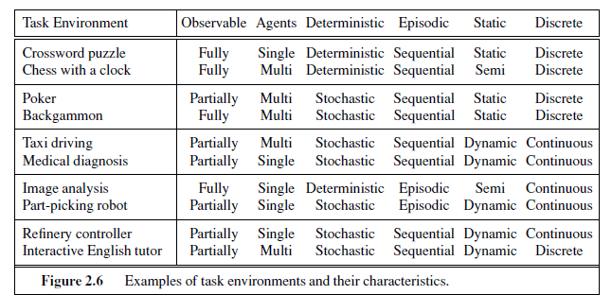

Slide 27
THE STRUCTURE OF AGENTS
The job of AI is to design an agent program that implements the agent function— the mapping from percepts to actions.
program will run on computing device with physical sensors and actuators—the architecture:
agent = architecture + program

Slide 28
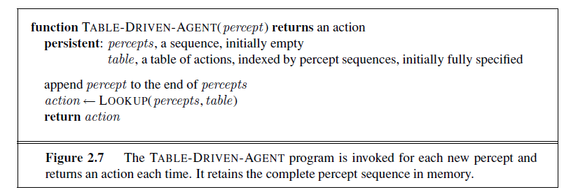
THE STRUCTURE OF AGENTS
Agent programs
The agent program takes just the current percept as input;
If the agent’s actions need to depend on the entire percept sequence, the agent will have to remember the percepts.

Slide 29

Agent programs
Let P be the set of possible percepts and let T be the lifetime of the agent (the total number of percepts it will receive).
The lookup table will contain entries.
Ex: Consider the automated taxi: the visual input from a single camera comes in at therate of roughly 27 megabytes per second (30 frames per second, 640×480 pixels with 24bits of color information). This gives a lookup table with over 10^{250,000,000,000} entries for an hour’s driving.

Slide 30
THE STRUCTURE OF AGENTS
Agent programs
size of these tables
Table entries are larger
Designer would not have time to create the table
All the right table entries cannot be learnt from its experience,
d) In a simple environment lack of guidance to fill the table entry is requirred .

Slide 31
TABLE-DRIVEN-AGENT does do what we want: it implements the desired agent function.
Simple reflex agents;
Model-based reflex agents;
Goal-based agents; and
Utility-based agents.

Slide 32
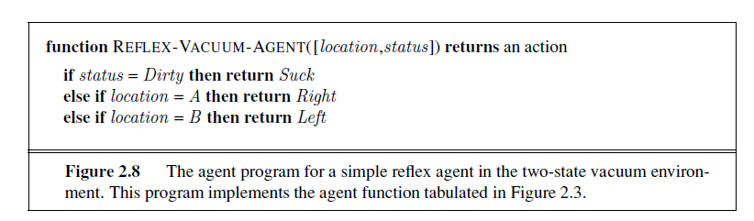
Simple reflex agents
simplest kind of agent.
Select actions based on current percept, ignoring percept history
Ex: vacuum agent: its decision is based only on the current location and on whether that location contains dirt.

Slide 33
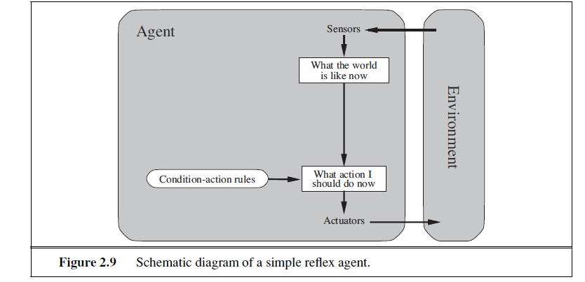
condition–action rule: automated taxi If the car in front brakes and its brake lights come on, then you should notice this and initiate braking. In other words, some processing is done on the visual input to establish the condition we call “The car in front is braking.” Then, this triggers some established connection in the agent program to the action “initiate braking. if car-in-front-is-braking then initiate-braking
rectangles to denote the current internal state of the agent’s decision process,
ovals to represent the background information used in the process.

Slide 34
condition–action rule: if car-in-front-is-braking then initiate-braking
Rectangles:current internal state of the agent’s decision process
Ovals:background information used in the process.

Slide 35
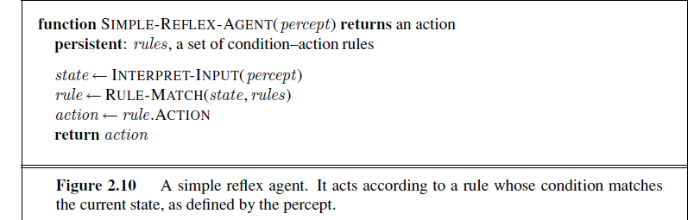
actual implementations :using logic gates with a Boolean circuit.
Limitations:
1.Admirable property of being simple, but they turn out to be of limited intelligence.
Ex: only the current percept—that is, only if the environment is fully observable.
Example: Car Braking .
2.Escape from infinite loops is possible if the agent can randomize its actions.

Slide 36
actual implementations :using logic gates with a Boolean circuit.
Limitations:
1.admirable property of being simple, but they turn out to be of limited intelligence.
Ex: only the current percept—that is, only if the environment is fully observable.
Suppose that a simple reflexvacuum agent is deprived of its location sensor and has only a dirt sensor. Such an agent
has just two possible percepts: [Dirty] and [Clean]. It can Suck in response to [Dirty]; what should it do in response to [Clean]? Moving Left fails (forever) if it happens to start in square A, and moving Right fails (forever) if it happens to start in square B. Infinite loops are often unavoidable for simple reflex agents operating in partially observable environments
2.Escape from infinite loops is possible if the agent can randomize its actions.
For example, if the vacuum agent perceives [Clean], it might flip a coin to choose between Left and Right . It is easy to show that the agent will reach the other square in an average of two steps. Then, if that square is dirty, the agent will clean it and the task will be complete. Hence, a randomized simple reflex agent might outperform a deterministic simple reflex agent.

Slide 37
Model-based reflex agents
The solution to partial observability is to keep track of the part of the world it can’t see now.
Agent – Maintain internal state with percept history and thereby reflects at least some of the unobserved aspects of the current state.

Slide 38
Model-based reflex agents
Updating the internal states
First, some information about how the world evolves independently of the agent
Ex: Overtaking car generally will be closer behind than it was a moment ago.
Second, need some information about how the agent’s own actions affect the world
Ex: when the agent turns the steering wheel clockwise, the car turns to the right, or anticlockwise towards left.

Slide 39
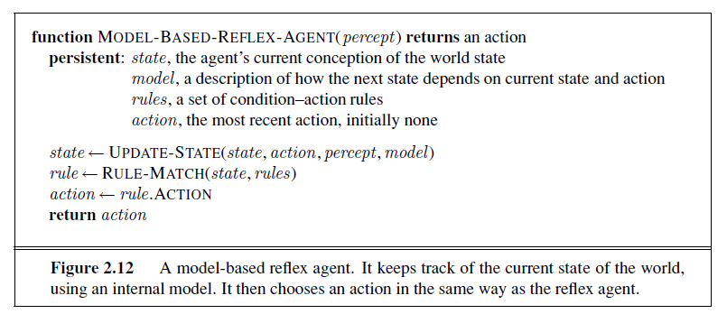
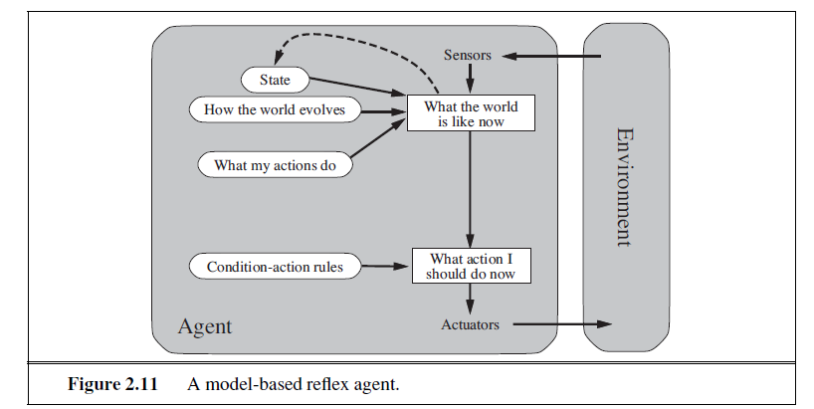
Model-based reflex agents
knowledge about “how the world work is called a model of the world. An agent that uses such a model is called a model-based agent.

Slide 40
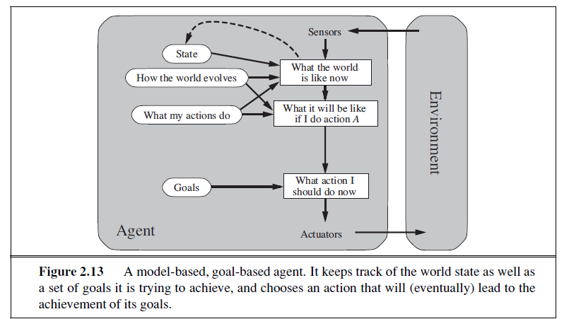
Goal-based agents
current state description, the GOAL agent needs some sort of goal information with situation desirable Ex: passenger’s destination.
The agent program can combine this with the model actions that achieve the goal.

Slide 41
Goal-based agents
when goal satisfaction results immediately from a single action. Sometimes it will be more tricky—for example, when the agent has to consider long sequences of twists and turns in order to find a way to achieve the goal. Search and planning are the subfields of AI devoted to finding action sequences that achieve the agent’s goals.
Ex:The reflex agent brakes when it sees brake lights. A goal-based agent, in principle, could reason that if the car in front has its brake lights on, it will slow down

Slide 42
Difference between goal based and reflex agents
Goal based :
Less efficient, it is more flexible because the knowledge that supports its decisions is represented explicitly and can be modified.
The goal-based agent’s behavior can easily be changed to go to a different destination, simply by specifying that destination as the goal
Reflex agent,
Need to rewrite many condition–action rules.
The reflex agent’s rules for when to turn and when to go straight will work only for a single destination; they must all be replaced to go somewhere new

Slide 43
Utility-based agents
Goals- “happy” and “unhappy” states.
Because “happy” is not very scientific, economists and computer scientists use the term utility instead
An agent’s utility function is performance measure.
If the internal utility function and the external performance measure are in agreement, then an agent that chooses actions to maximize its utility will be rational according to the external performance measure.
many advantages in terms of flexibility and learning.

Slide 44
Utility-based agents
goals are inadequate but a utility-based agent can still make rational decisions.
First, when there are conflicting goals, only some of which can be achieved (for example, speed and safety), the utility function specifies the appropriate tradeoff.
Second, decision making under uncertainty

Slide 45
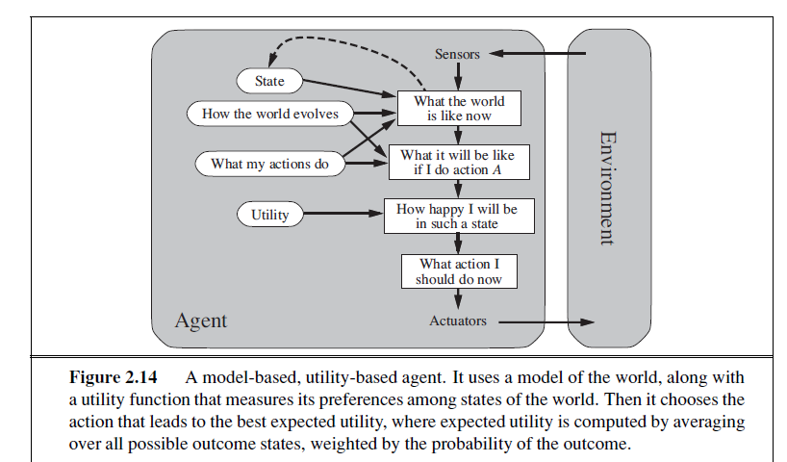
Utility-based agents

Slide 46
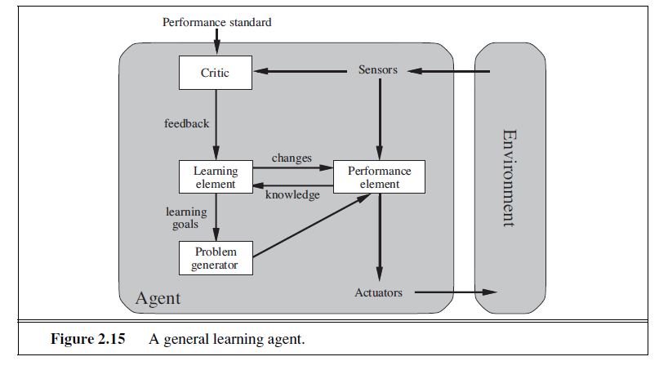
Learning agents
how the agent programs come into being

Slide 47
Learning agents
Learning element- A learning agent can be divided into four conceptual components which is responsible for making improvements
2. Performance element- which is responsible for selecting external actions.
The performance element is what we have previously considered to be the entire agent: it takes in percepts and decides on actions.
3. critic :The learning element uses feedback from the critic on how the agent is doing and determines how the performance element should be modified to do better in the future.
4. problem generator The last component of the learning agent is the problem generator ,suggesting actions that will lead to new and informative experiences.
if the performance element had its way, it would keep doing the actions that are best, given what it knows.

Slide 48
the performance standard distinguishes part of the incoming percept as a reward (or penalty) that provides direct feedback on the quality of the agent’s behavior.

Slide 49
How the components of agent programs work
What is the world like now?”
“What action should I do now?”
“What do my actions do?”
next question for a student of AI How on earth do these components work?”
representations along an axis of increasing complexity and expressive power—atomic, factored, and structured

Slide 50
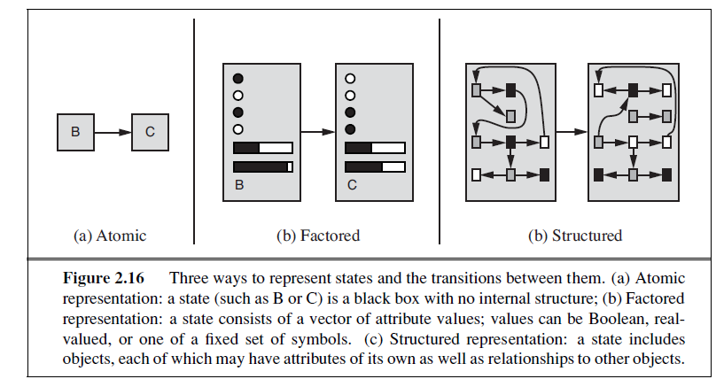

Slide 51
How the components of agent programs work
atomic representation
each state of the world is indivisible-it has no internal structure.
Ex:just atomic location in one city or another.
factored representation
splits up each state into a fixed set of variables or attributes, each of which can have a value.
how much gas is in the tank, our current GPS coordinates, whether or not the oil warning light is working, how much spare change we have for toll crossings, what station is on the radio, and so on.

Slide 52
While two different atomic states have nothing in common—they are just different black boxes—two different factored states can share some attributes (such as being at some particular GPS location) and not others (such as having lots of gas or having no gas); this makes it much easier to work out how to turn one state into another. With factored representations, we can also represent uncertainty—for
example, ignorance about the amount of gas in the tank can be represented by leaving that attribute blank

Slide 53
structured representation
Ex: TruckAheadBackingIntoDairyFarmDrivewayBlockedByLooseCow with value true or false
For example, we might notice that a large truck ahead of us is reversing into the driveway of a dairy farm but a cow has got loose and is blocking the truck’s path.
Need to understand the world as having things in it that are related to each other, not just variables with values.

